Slide 1

UV Index Data Chart
Southern Skin Cancer Treatment of America
Sabrina Kabir

Slide 2
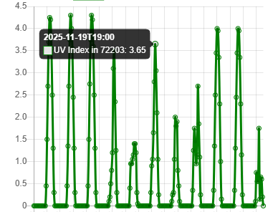
Company Background
Southern Skin Cancer Treatment of America
Purpose
How will this project help the company?

Slide 3
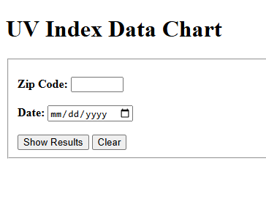
Project Specifications
Project Requirements
What programming languages were
used?
User Interface Design

Slide 4
Project Link
Here is the link to access the project:
https://sabrina200424.github.io/portfolio/UV-Index-Project/index.html

